Slide 1
USING RESEARCH4LIFE

Slide 2
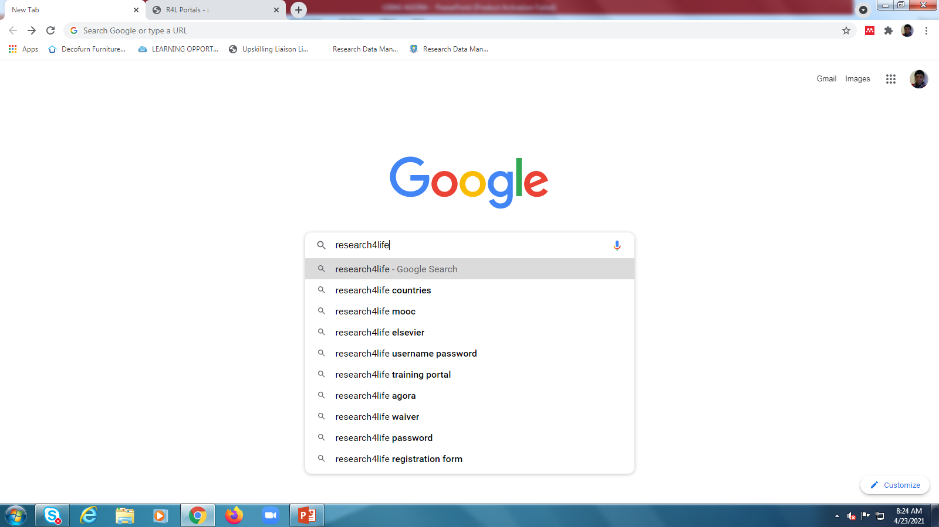
On your web browser type Research4Life
Click Library

Slide 3
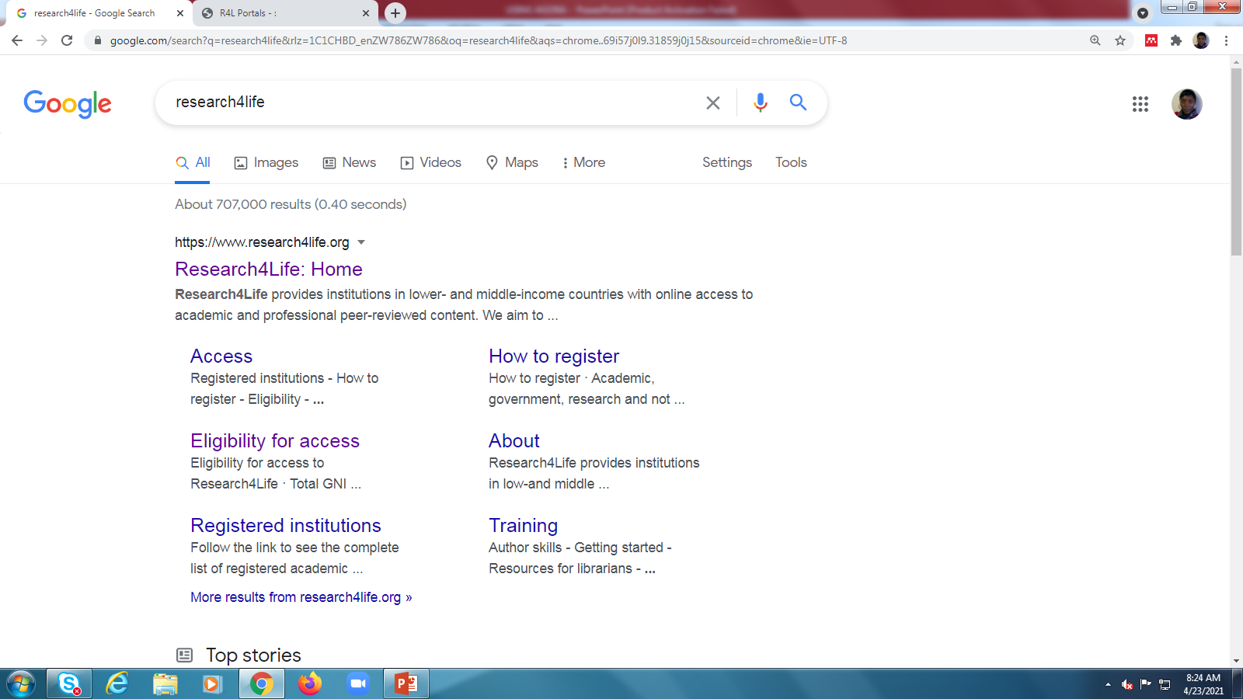
Click here

Slide 4
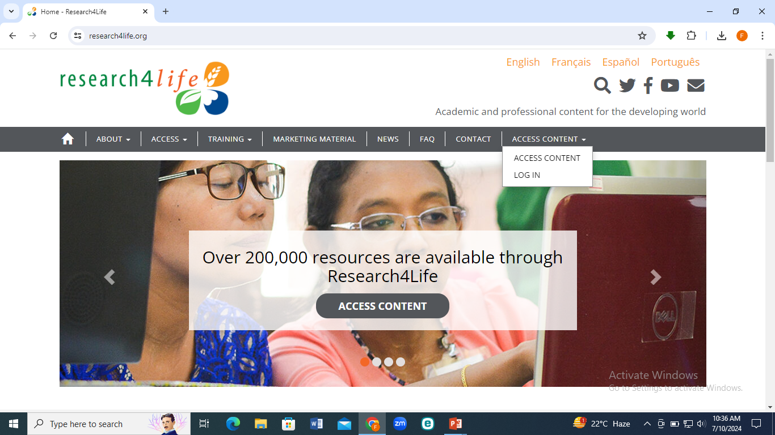
Log in using the log in details

Slide 5
Login details
Username: ZIM009
Password: 20268

Slide 6
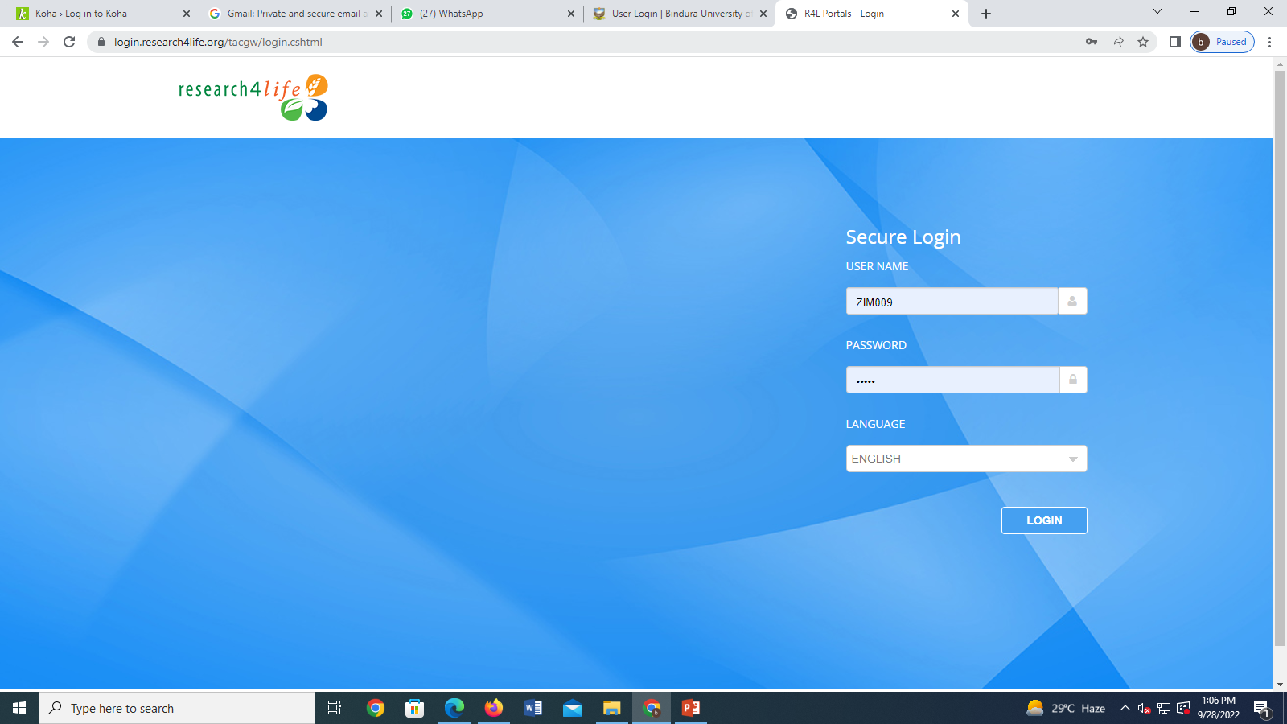
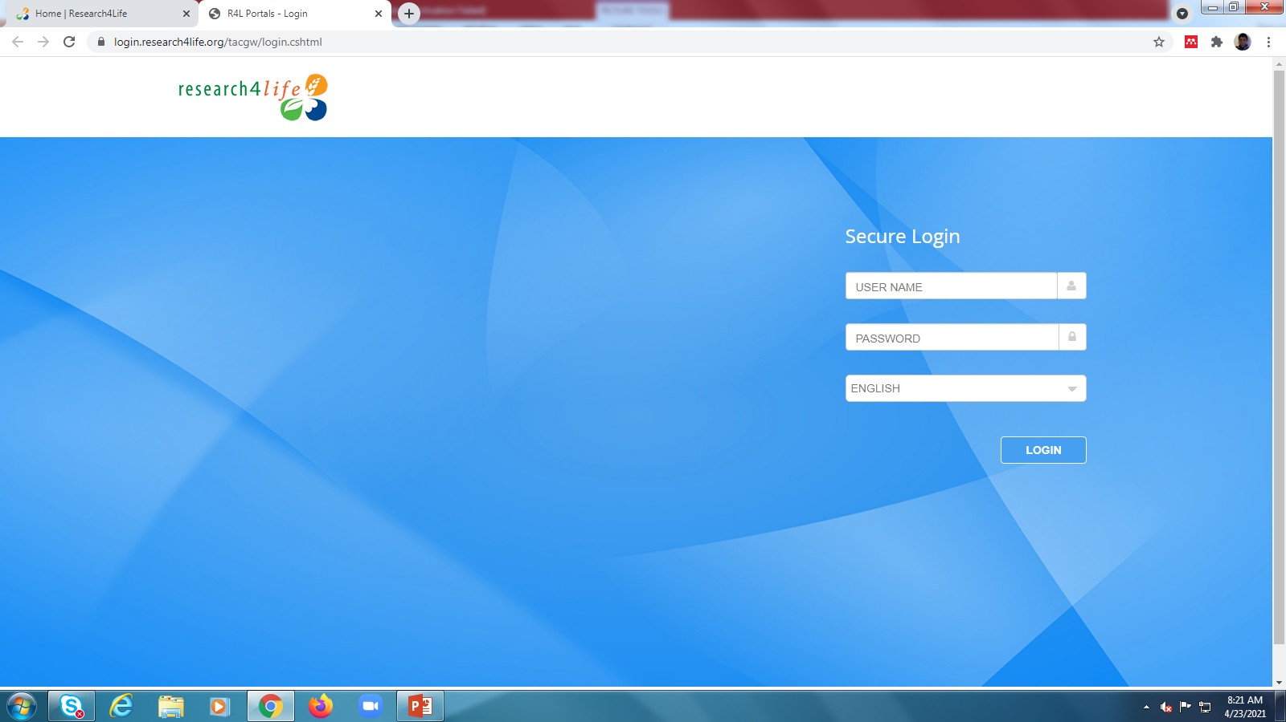
Click

Slide 7
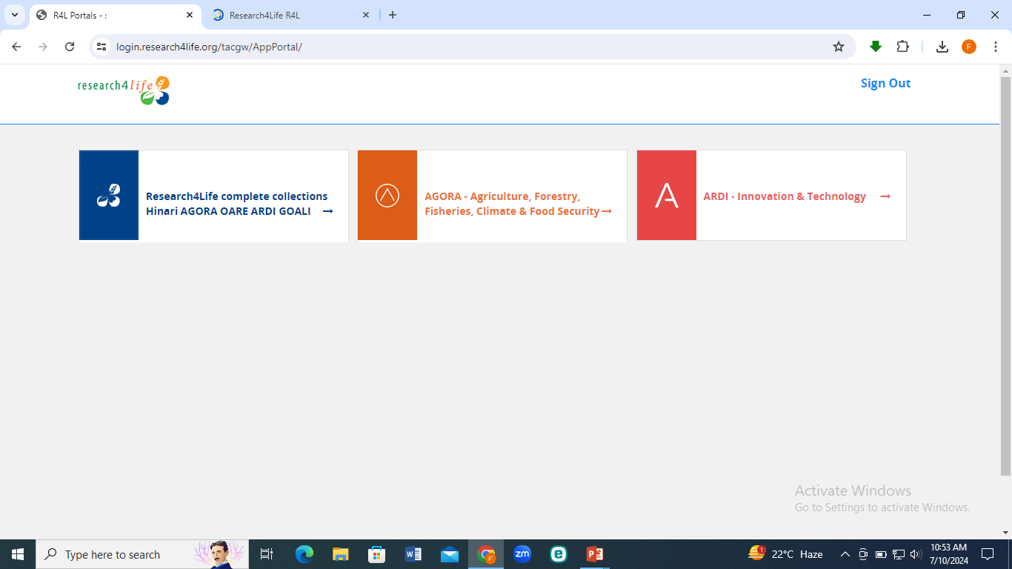

Click here

Slide 8

Type search terms and click search icon

Slide 9
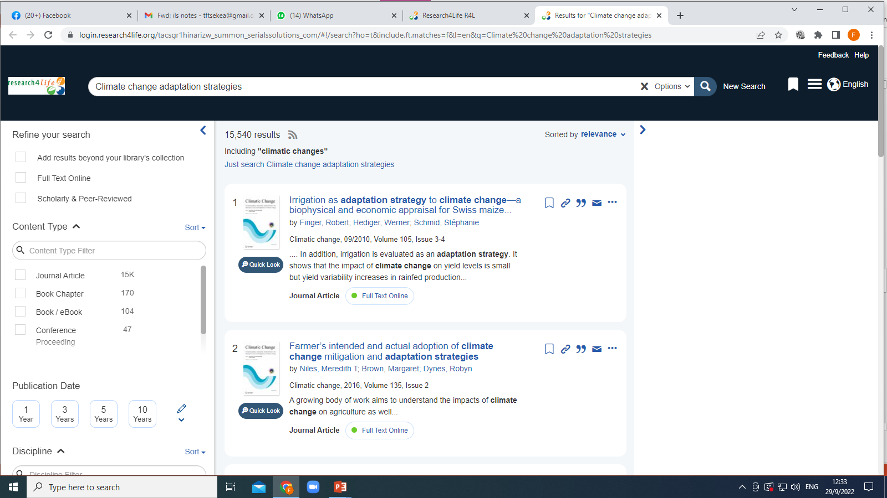
Click here to open article
Use filters to refine your search

Slide 10
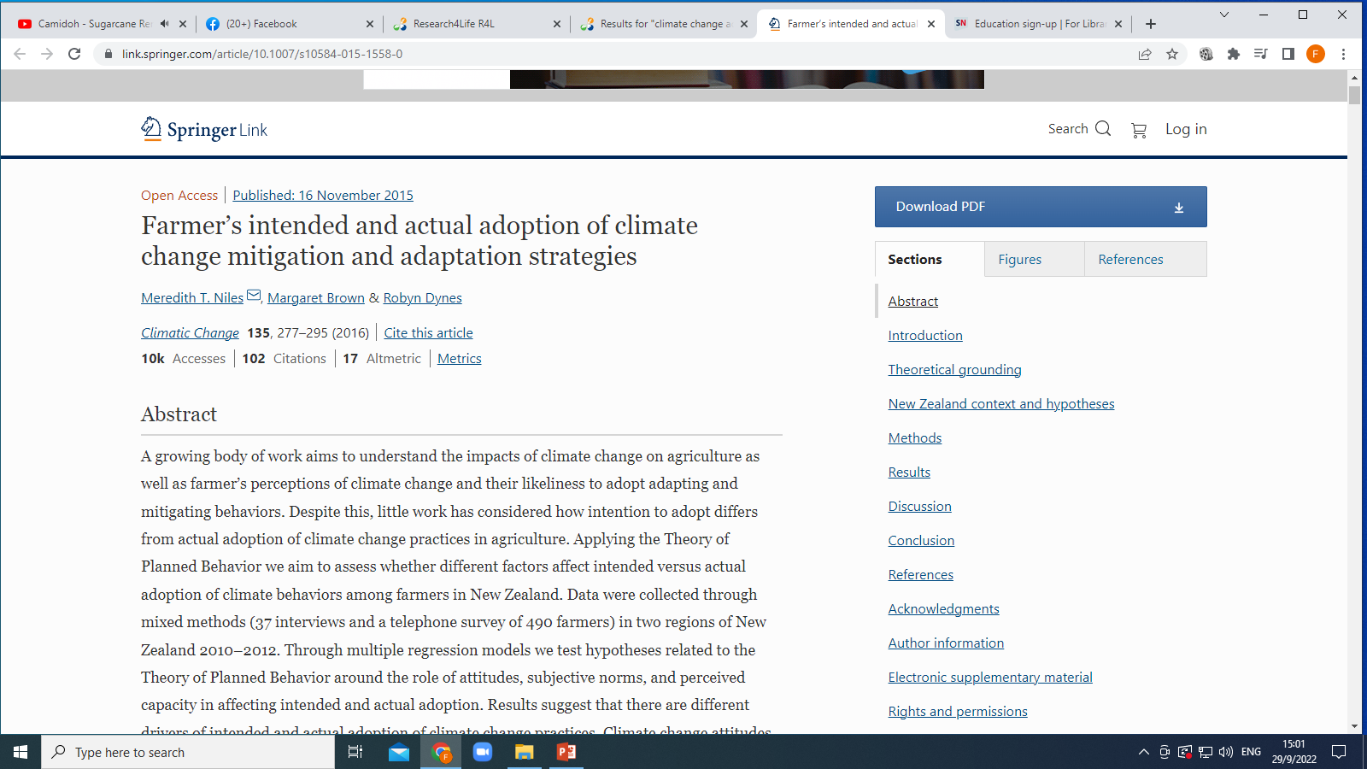
Click here to download article

Slide 11
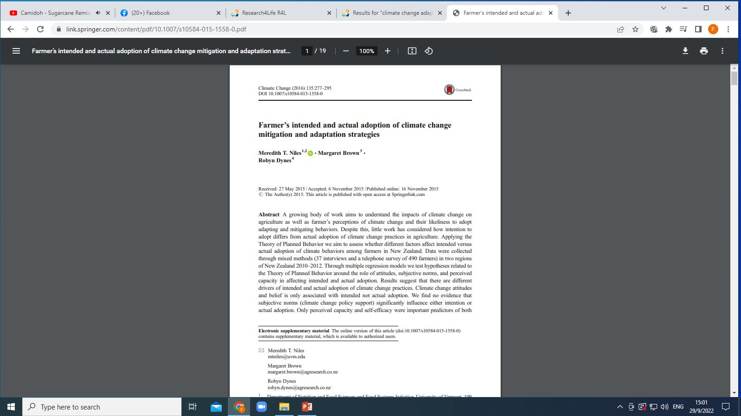

Slide 12
THANK YOU

